Slide 1
Ship To Module – Supporting Documentation Guide
How to add attachments to the barcode
Central Supplier Quality
Missiles and Fire Control

Slide 2
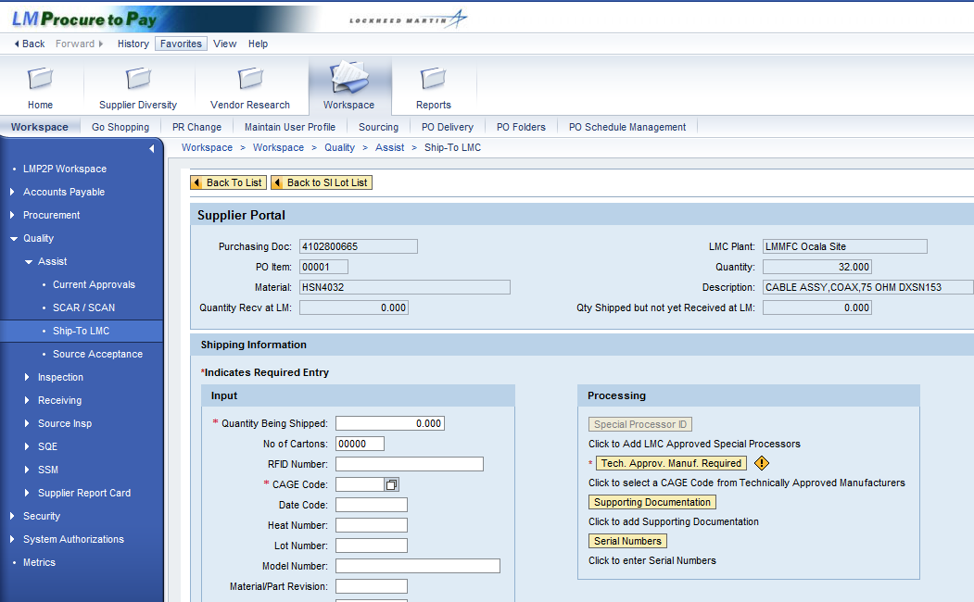
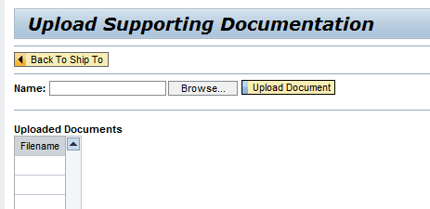
Ship To – Uploading Supporting Documents
The new MFC-**-*** quality notes require suppliers to submit all documentation electronically. Suppliers will need to create attachments to the barcodes by clicking the “Supporting Documentation” button in the Ship To module. In the Upload Supporting Documentation screen, select the file(s) to upload based on the requirements on the purchase order quality notes. If multiple documentation requirements are flowed out on the purchase order, they can be uploaded individually or combined within a single PDF file.
“The Seller shall submit all data and documentation electronically using the P2P Ship To module via Exostar (https://portal.exostar.com) prior to each shipment.”

Slide 3
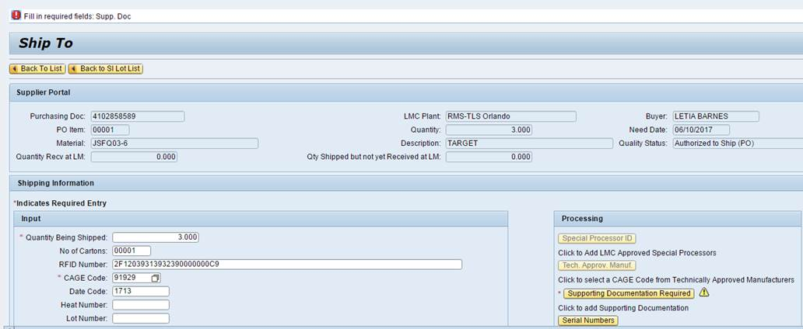
“Fill in Required Fields: Supp Doc” Error
If supporting documentation is not uploaded when required by the quality notes on the purchase order, the supplier will get the following error when attempting to create the barcode:
Click on the “Supporting Documentation Required” button to add attachments to the barcode. If multiple documentation requirements are flowed out on the purchase order, they can be uploaded individually or combined within a single PDF file.

Slide 4
PO Quality Notes with this requirement
New MFC Note | Consolidated Name
MFC-DC-002 | Electronic Submission of Data – Autoflow
MFC-DC-010 | Inspection Data
MFC-DC-011 | Failure Analysis
MFC-DC-012 | X-ray Data
MFC-DC-018 | Functional Test Reports
MFC-DC-019 | Ultrasonic Data
MFC-PR-012 | Unique Identification of Tangible Assets (UID)
MFC-TS-001 | Solderability Testing
MFC-PK-003 | Component Packaging
MFC-PK-006 | Moisture Sensitive Devices
New MFC Note | Consolidated Name
MFC-DC-003 | Certificate of Conformance
MFC-DC-004 | PAC-3 Parts Library
MFC-DC-007 | Gear Test Tape
MFC-DC-008 | As Built Configuration List
MFC-DC-014 | Electric Test Data
MFC-IN-013 | First Piece Inspection
MFC-IN-014 | 100% Inspection
MFC-PK-007 | Drop Shipment
MFC-DC-009 | Chemical/Physical Test Reports

Slide 5
EXOSTAR Help Desk Information
For any questions with the ship-to module or your purchase order, please reach out to your Lockheed Martin buyer POC
Should you have any questions or need technical support with your EXOSTAR login or company profile please reach out to EXOSTAR:
 | Phone:
EXOSTAR Help Desk: | (703) 793-7800
FAQs, additional information and LMP2P Support Guides are available at the following link:
http://www.myexostar.com/myexostarAll.aspx?id=1362
Ship to LMC This quick reference guide displays the procedure to Ship to Lockheed Martin.

