Slide 1
Failure Investigation Process
Fault Tree Analysis

Slide 2
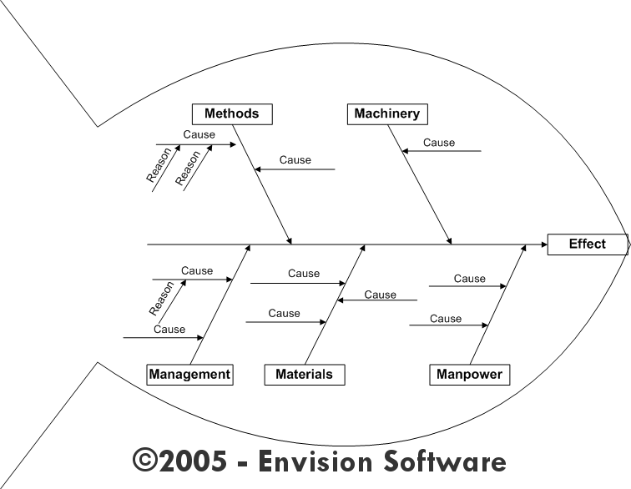
Failure Investigation Process
Examples of tools that exist to investigate failures:
MFC tends to use Fault Tree; suppliers tend to use Fishbone Charts
Failure description
1.0 R Open
(POC Name)
2.0 R Open
(POC Name)
3.0 R Open
(POC Name)
4.0 R Open
(POC Name)
Cause 1
Cause 2
Cause 3
Cause 4
2.1 R Open
(POC Name)
Cause 2.1
Fishbone Chart
Fault Tree

Slide 3
Fault Tree: What it is
It is a method for focusing the team on identifying root cause of a failure so that appropriate corrective action can be applied to mitigate repeat failures of the same nature
It is a TOOL that should be used often; the more often it used, the faster the process of using it becomes second nature
As a tool, it enhances technical interchange between users and suppliers of subsystems
It provides a repository for design details and test results that can easily be accessed in the future
It is NOT intended to assign blame
It is NOT a panacea; conclusions drawn are only as good as the input criteria
It is NOT absolute; because of the complexity of some systems, it may not present a single ROOT CAUSE

Slide 4
The Fault Tree: How it is used
The FAULT TREE is used in conjunction with 6-way charts
The START of the Fault Tree is the top level failure description, in general terms
The Lower Level Blocks are the possible causes of the noted failure
The 6-Way Charts are used to assess each of the Lower Level Blocks
ALL Lower Level Blocks start as RED (Primary cause of the failure)
6-ways are used to modify the color from RED and up
When does it end?
When the arguments cease!!
Mike’s Rule of Thumb:
When no other blocks can be added to fault tree AND when testing avenues have been depleted

Slide 5
The 6-way form: How it is used
The 6-way form consists of several blocks that require the investigator(s) input to complete:
Be specific as to how this item
can cause the failure
Detail evidence as to why this
item IS a candidate cause
Detail evidence as to why this
item is NOT a candidate cause
Detail list of tests/analyses
necessary to validate failure
hypothesis
Detail results of testing
Root Cause Analysis Summary
Observed Failure: | Activity During Which Failure Occurred:
(Provide details about the observed failure) | (During what event did the failure occur)
 | Location Where Failure Occurred:
 | (Where was the system when failure occurred)
 | Failure Date: |  | (Date of Failure)
Candidate Cause of Failure: | Tracking Number | Probability Index |  | Status | Date
(Describe the candidate cause – ties back to the item identified on the fault tree)
 | 1.1 | Red |  | Open
 | Investigator: | (Name)
Evidence For: | Evidence Against:
(Provide any details for why this may be the cause of the failure) | (Provide any details that may rule this item out as to the cause of the failure)
Required tests or analyses | Results of tests or analyses
(Define actions/tests to be performed to determine if this is the cause of the failure – Identify person to be responsible and expected completion date) | (Provide details as to the results of the testing – place any data in the “Supporting Data” folder on the sharepoint site)
Is this a probable cause of the observed failure?
No
Recommended Corrective Action
N/A

